Slide 1

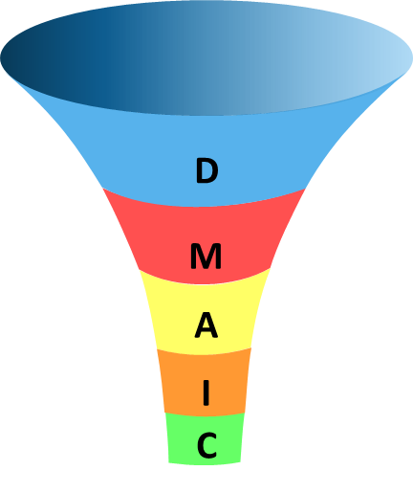
Containerboard Throughput Process on 282 D/C
Max Ermler

Slide 2


Project Goal
D | M | A | I | C
Objective
Decrease order lead time on 282 D/C
Increase Throughput on the 282 D/C in terms of MSF/Machine Hr
Increase machine consistency
Benefits
This project resulted in a contribution of $863,700
Notes:
3

Slide 3



Six Sigma Team Members
D | M | A | I | C
Champion
Area Operations Manager - Randy Burns
Green Belt or Black Belt
Mr. Max Ermler
Mr. Henry Velasquez
Mr. Abe Shakara
Team
Consulting Members/Customers
Production Manager – Craig Peterson
Superintendent – Rory Heacock
Shift Supervisors
Area Quality Manager – RJ Schirtzinger

Slide 4
Project Charter
Six Sigma: Proposed Project Template
Product/Process Impacted | Containerboard Throughput Process on 282 D/C | Business Unit and Location |  | 282 Goepfert 3-color Die Cutter
Project Candidate Submitted By: | Maximillian Ermler | Telephone Number |  | (847) 579-8626
Champion who reviewed | Randy Burns | Telephone Number |  | (330) 281-3506
Start Date | Jan-23 | Target Completion Date |  | Jul-23
Element | Description | Team Charter
1. Process/Product: | The process in which opportunity exists | Containerboard order fullfillment process on the 282 D/C (G3)
2. Project Description: | Describe the project's purpose and scope | This project aims to increase the msf/machine hr by 40 %. In 2022, the msf/machine hr averaged 21.73, which is below the target of 30.42.
3. Objectives: | What improvement is targeted and what will be the impact? | Metrics | Baseline | Goal | Units
 |  | Throughput | 21.73 | 30.42 (40%) | MSF/Macine Hr
4. Business results:
 |  | Annual Savings from Six Sigma Project
 |  | Estimate: |  |  |  | Savings
 |  | Estimated savings (3 months worth) |  |  |  | $386,200.00
 |  | Estimated savings (6 months worth) |  |  |  | $772,400.00
 |  | Annual Savings of Project |  |  |  | $1,545,000.00
Payback | Projected payback in months | Average MSF/Machine hour in 2022 was 21.73 and had approximatley 5924 machine hours in 2022. If throughput is increased by 40%, the new msf/machine hr will be 30.42. Assuming similar machine hours in 2023, and that the difference in average msf will be 8.69, there will be an increase of 51491 MSF in 2023. The contribution $/MSF is 30. Therefore, 30$/msf * 51491 msf = $1,545,000 for the year
5. Benefit to External Customers: | Who are the final customers, what benefit will they see, and what are their most critical requirements? | Decreased order lead time (customer) Increased throughput (plant) Increased machine consistancy (operator) Better instructions for crew (crew)
6. Proposed Team Members | Who are the full time team members and any expert consultants? | Full time: POE (myself), two area engineers, 1st shift supervisor, Plant Superintendent, operations manager Experts: Randy Burns, Dustin Haas, RJ Schirtzinger
D | M | A | I | C

Slide 5

Baseline Data
D | M | A | I | C
The Goepfert 282 D/C averaged 21.73 msf/machine hr in 2023
Goal is to increase throughput by 40%

Slide 6

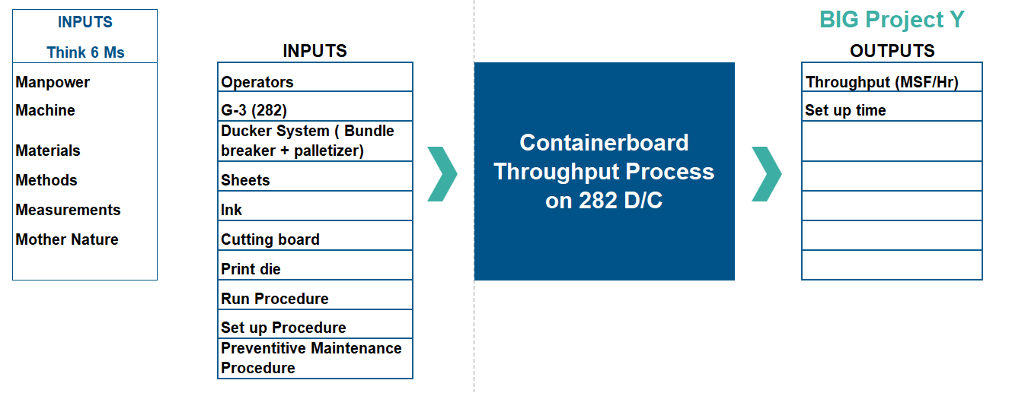
High Level Process Map
D
M
A
I
C

Slide 7
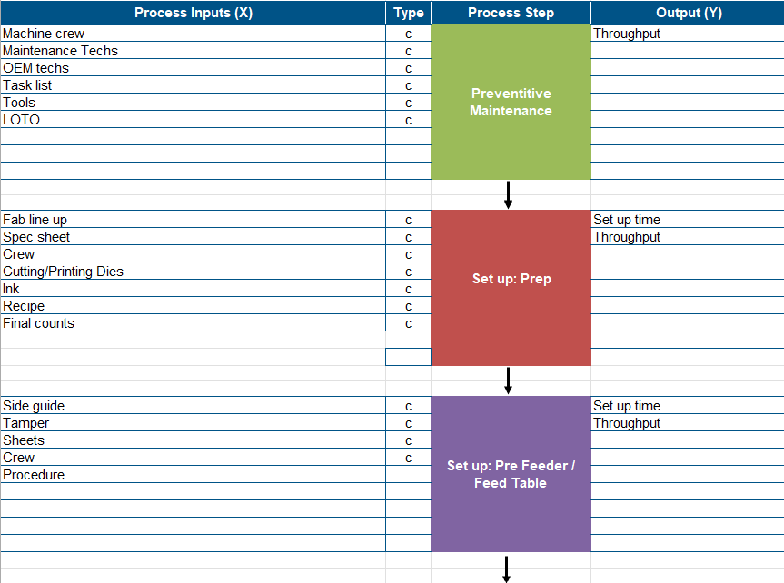
Detailed Process Map
D | M | A | I | C

Slide 8
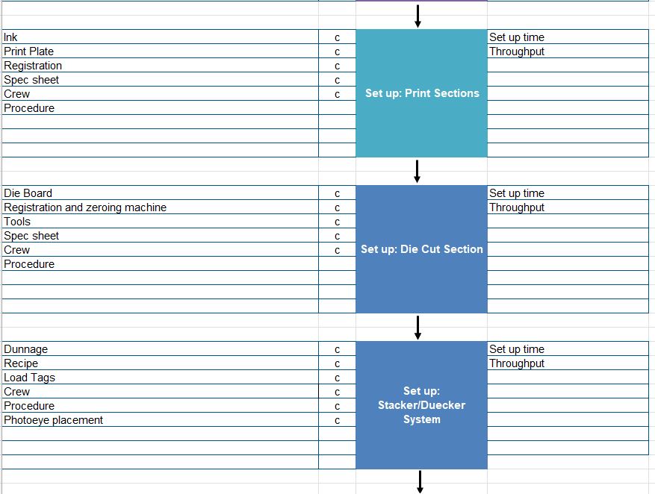
Detailed Process Map Cont.
D | M | A | I | C

Slide 9
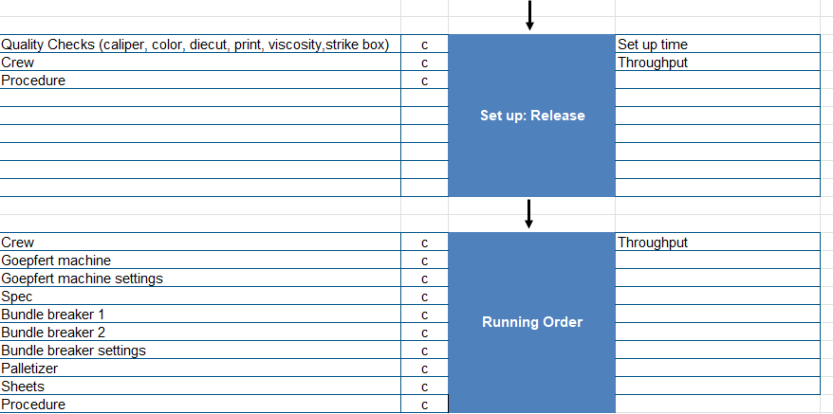
Detailed Process Map Cont.
D | M | A | I | C

Slide 10
Measurement Systems Analysis
D | M | A | I | C
Msf/MachineHr : Data from CTI/EFI was audited with simple calculation and observing. System calculates the data using the kicks/hour, total pieces in the order, and total time the machine is scheduled. These values were audited and confirmed to be correct
Downtime data did not appear to be accurate, so it was excluded from the project.
Set up time data did not appear to be accurate, so it was excluded from the project.

Slide 11
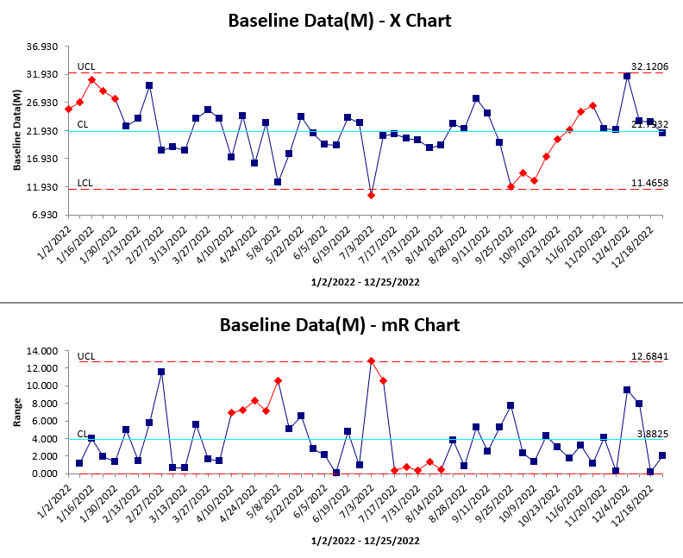
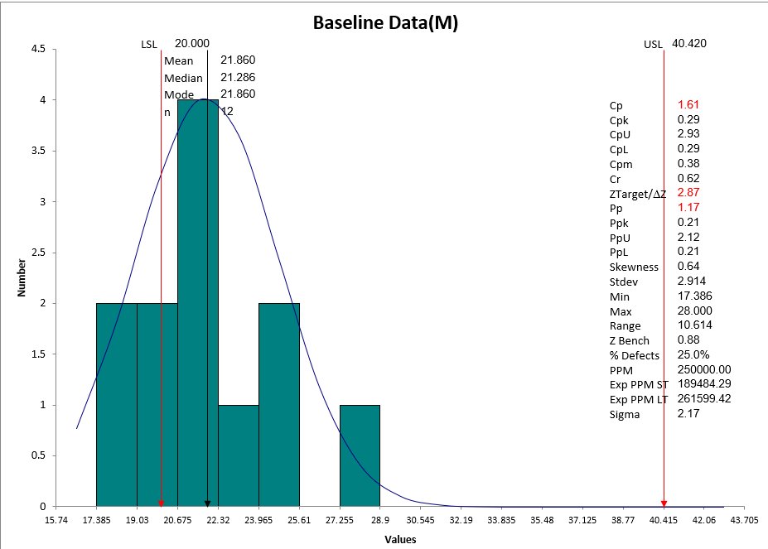
Process Charts Before Project (Msf/MachineHr vs Week)
D | M | A | I | C

Slide 12
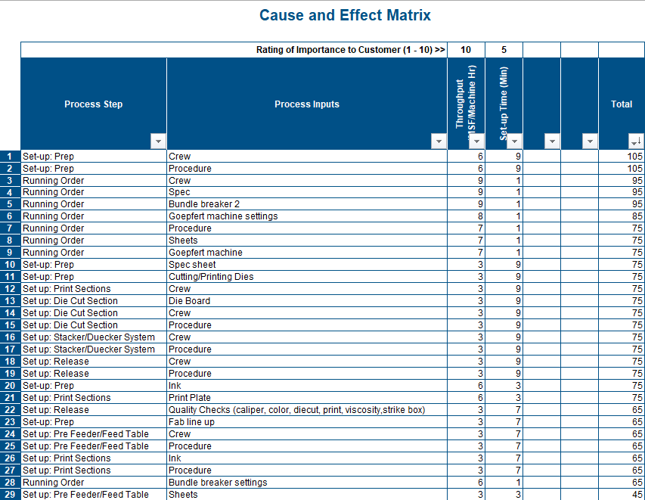
D | M | A | I | C

Slide 13
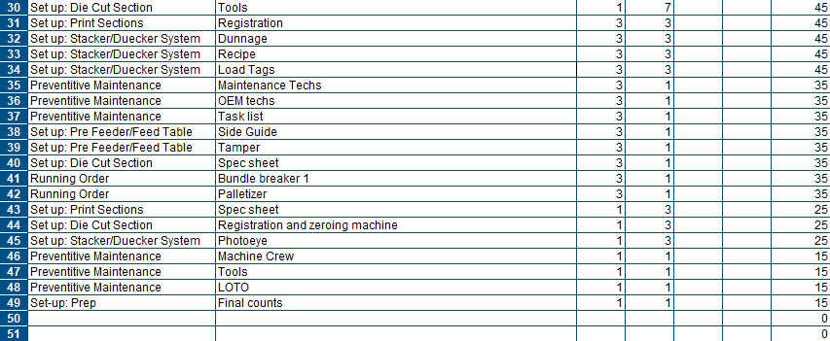
Cause and Effects Matrix Cont.
D | M | A | I | C

Slide 14
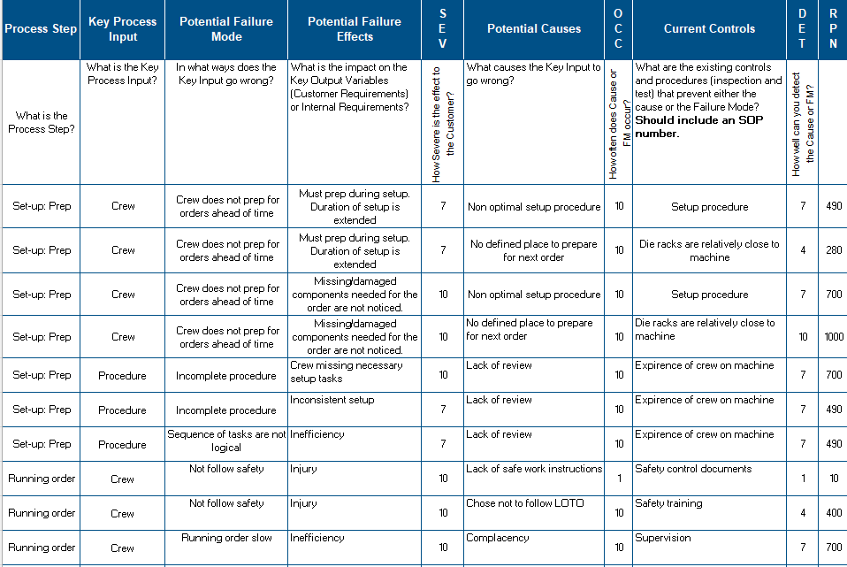
Preliminary FMEA
D | M | A | I | C

Slide 15
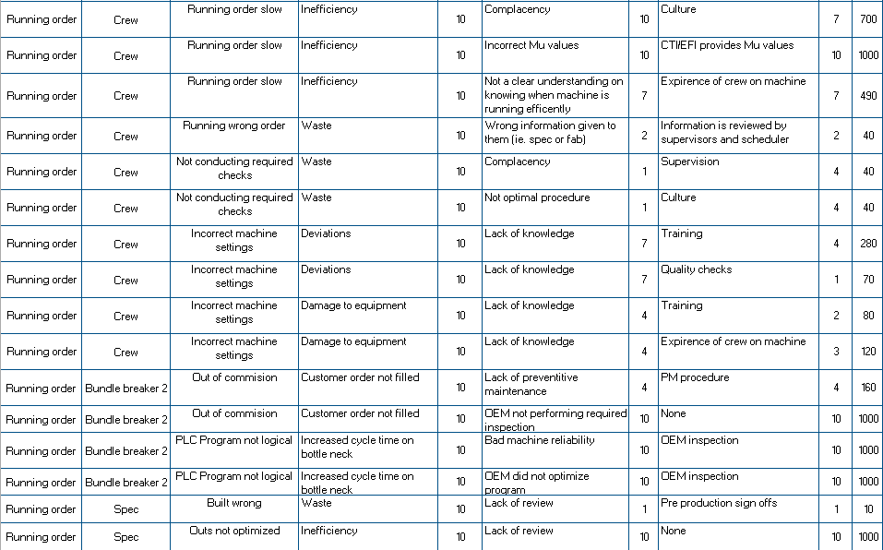
Preliminary FMEA Cont.
D | M | A | I | C

Slide 16
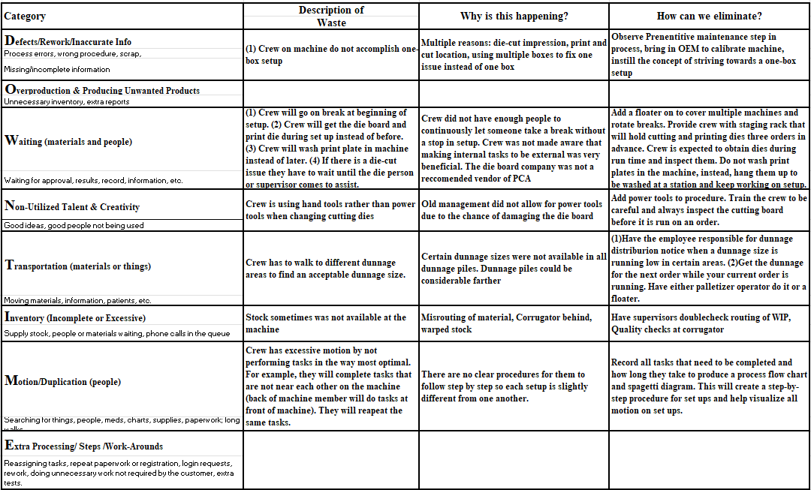
Waste Walk – Set ups
D | M | A | I | C

Slide 17
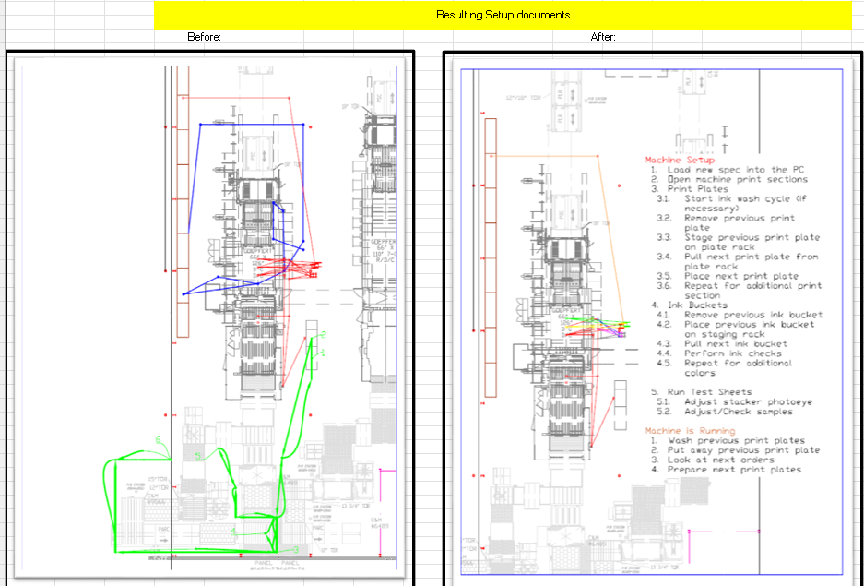
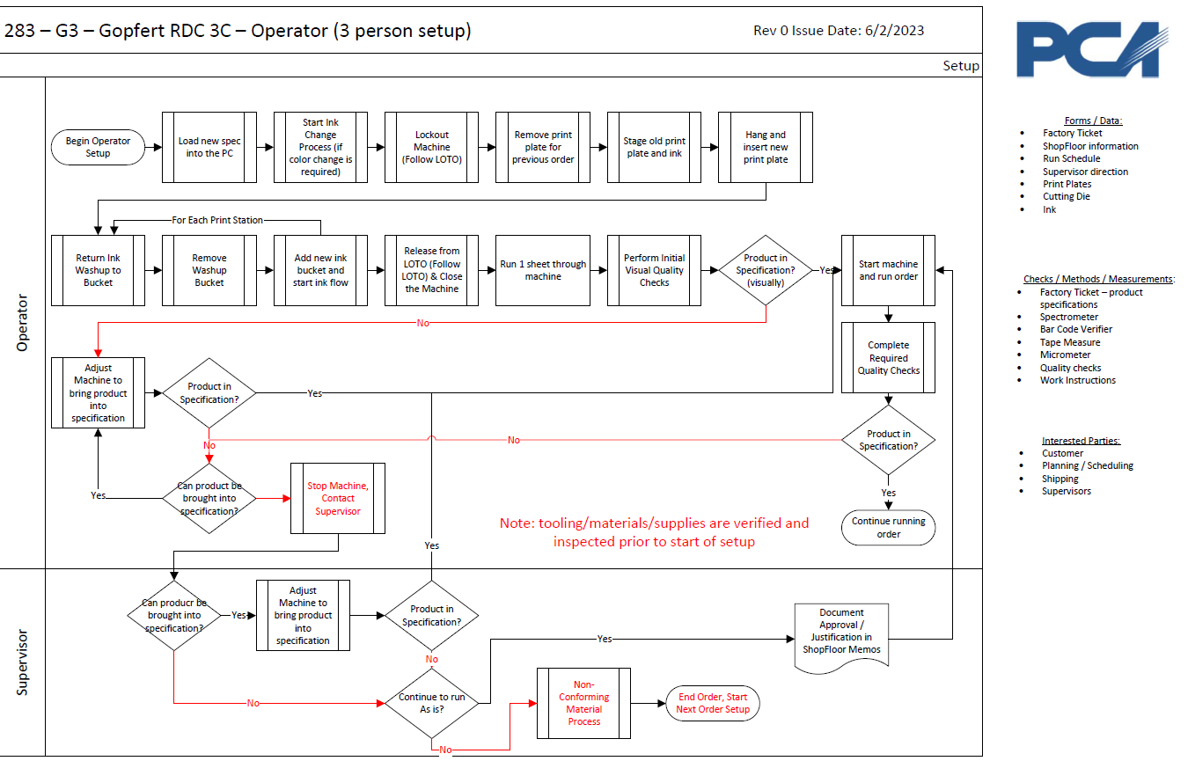
Spaghetti Diagram Showing Wasted Motion of Crew During Setup
D | M | A | I | C
New Procedure was created and Controlled. SOP was created

Slide 18
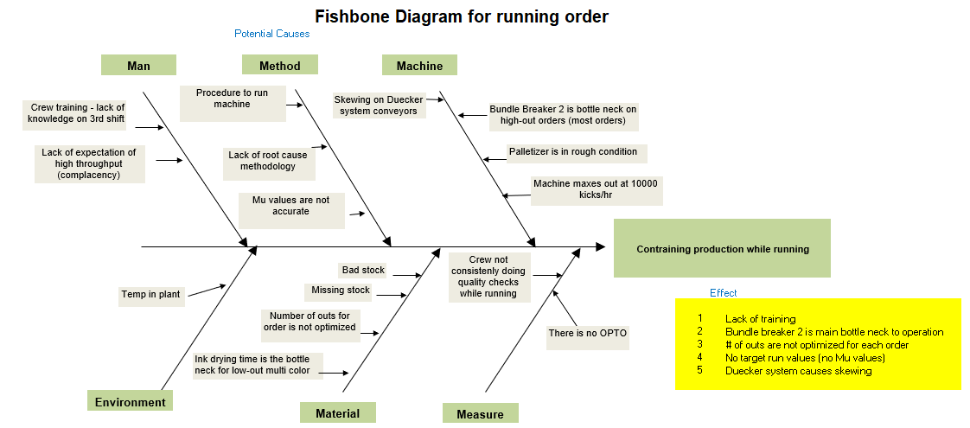
Root Cause Analysis: Cause & Effect Diagram
D | M | A | I | C

Slide 19
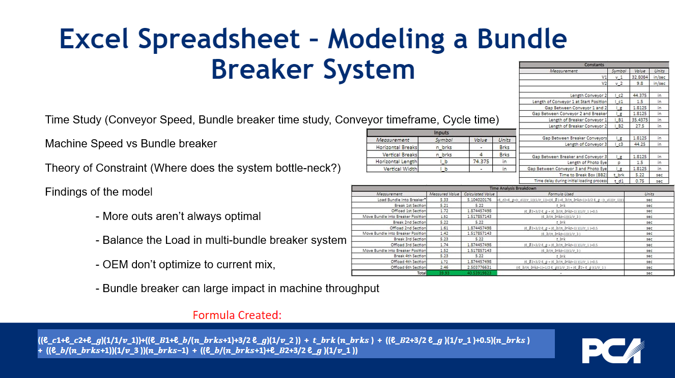
D | M | A | I | C

Slide 20
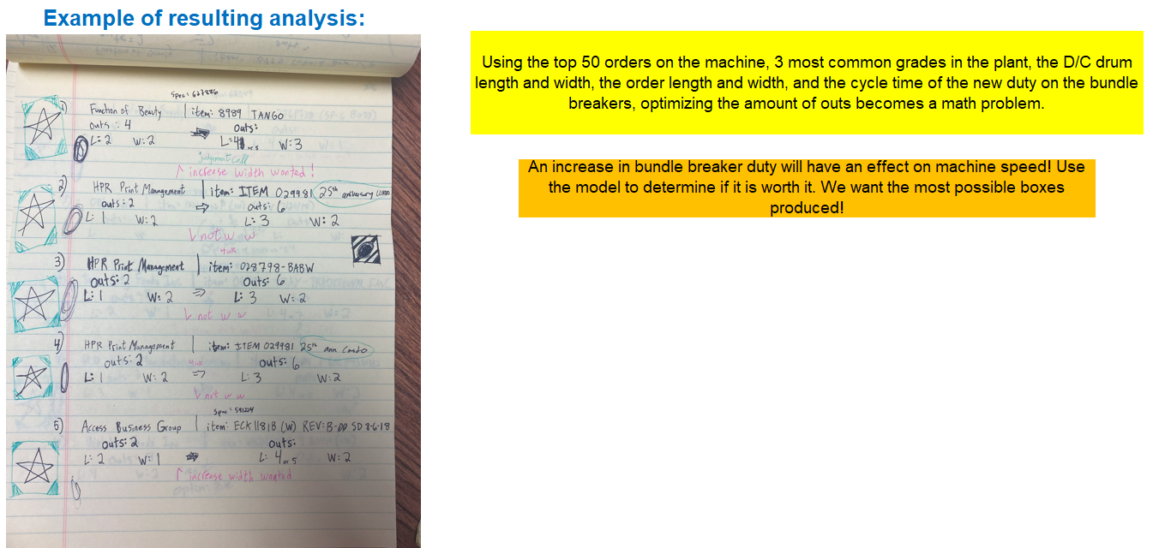
Modeling Bundle Breaker Cont.
D | M | A | I | C

Slide 21
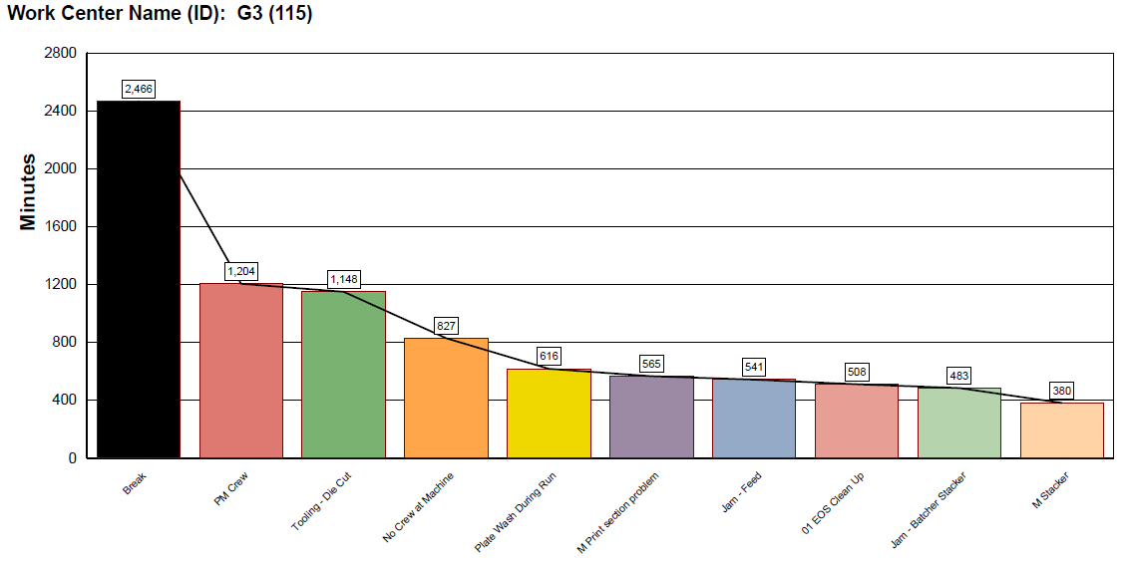
Machine Downtime Analysis
D | M | A | I | C
Pareto Chart shows top three downtimes

Slide 22
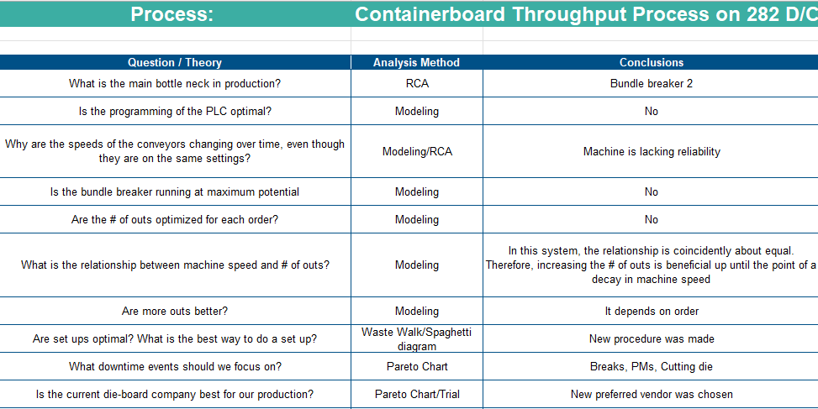
Questions/Conclusions
D | M | A | I | C

Slide 23
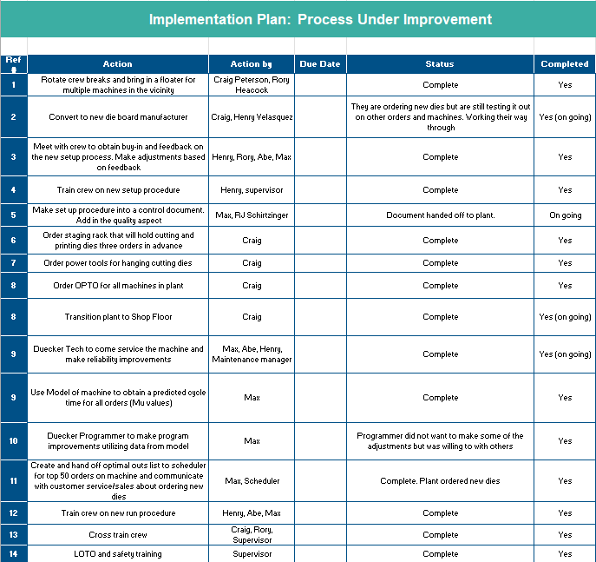
Improvement Plan
D | M | A | I | C

Slide 24
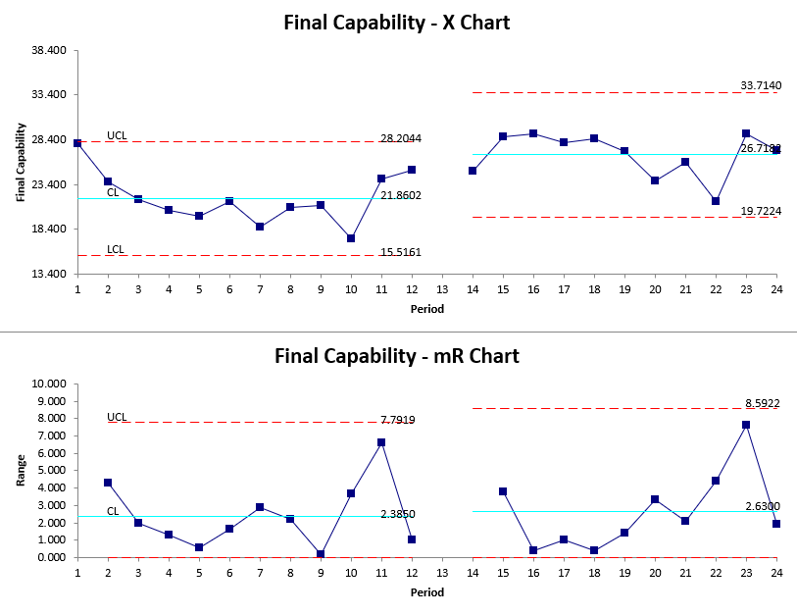
Improved Process
D | M | A | I | C
BEFORE
AFTER
Shows month over month of average Msf/MachHr starting Jan 2022
Monitoring (control) data was sampled once a month; Therefore, 2022 data is displayed by the month for a better comparison
Average MSF/MachineHr has improved by ~ 22%

Slide 25
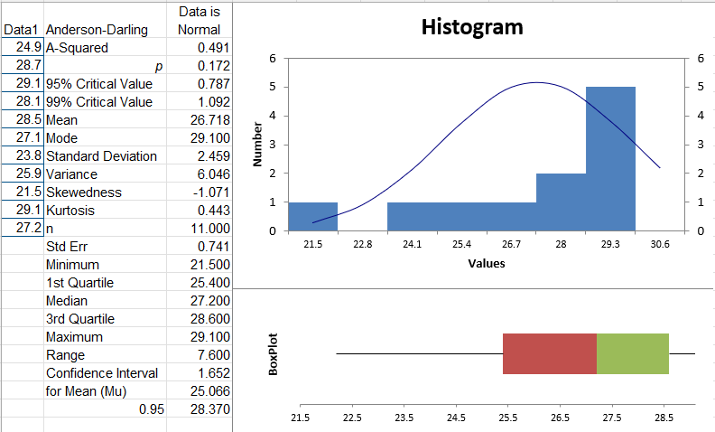
Updated Normality Test
D | M | A | I | C
Anderson-Darling P-value shows after data is normal

Slide 26
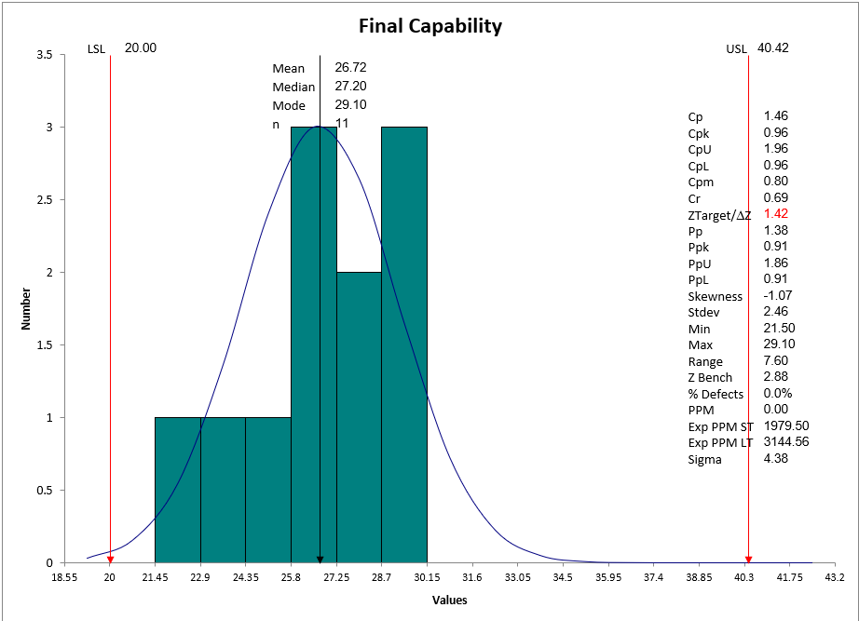
Improved Capability Analysis
D | M | A | I | C
New Cp = 1.46
New Cpk = 0.96

Slide 27
Previous State vs. Improved State (Monthly Samples)
D | M | A | I | C
BEFORE
AFTER

Slide 28
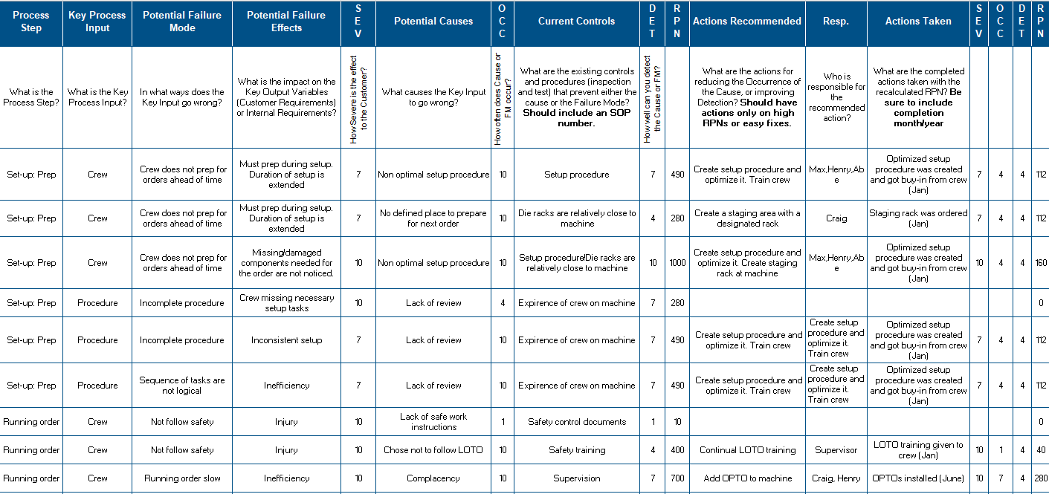
Final FMEA
D | M | A | I | C

Slide 29
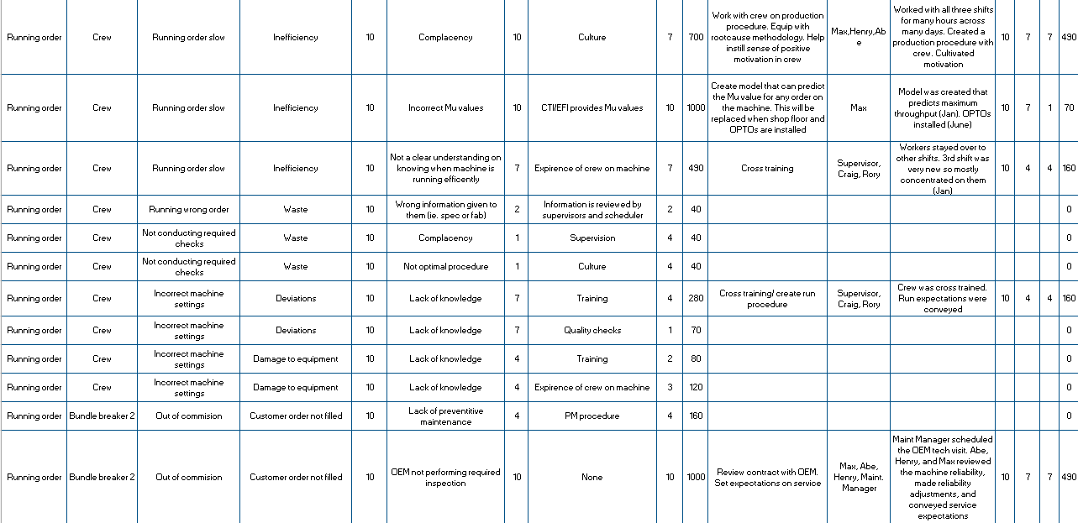
Final FMEA Cont.
D | M | A | I | C

Slide 30
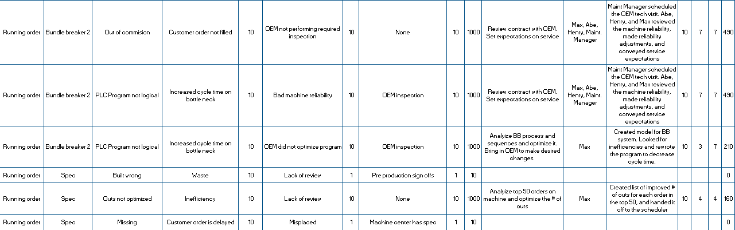
Final FMEA Cont.
D | M | A | I | C

Slide 31
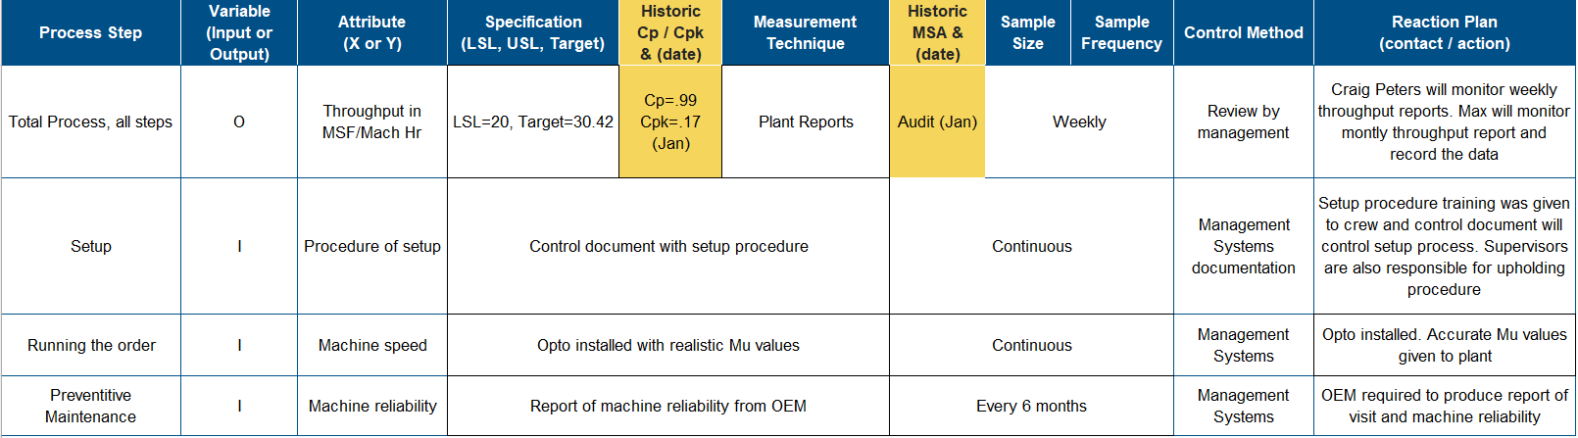
Control Plan - Manufacturing
D | M | A | I | C

Slide 32
Final Process Controls
D | M | A | I | C
Updates to Corporate Knowledge Base:
Document | Change | Owner | Completed
SOP for Goepfert 282 D/C | Machine Procedure adjusted | Grand Rapids | Yes
Project End – Proof of Sustainment:
FINAL RESULT: The Msf/MachineHr for the Goepfert 282 D/C was improved by 22% from before the project to completion. This resulted in a contribution of $863,700
32

